Slide 1

1000 Movies Data

Slide 2
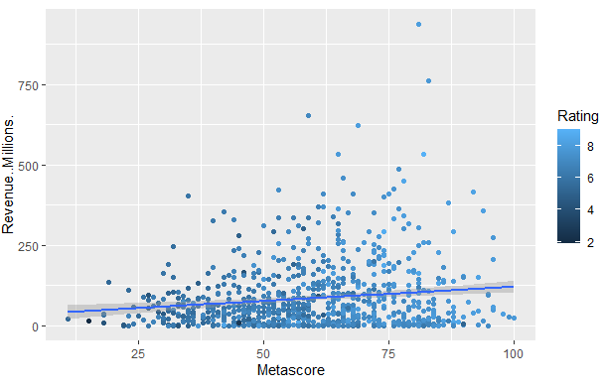
Metascore vs Revenue

Slide 3
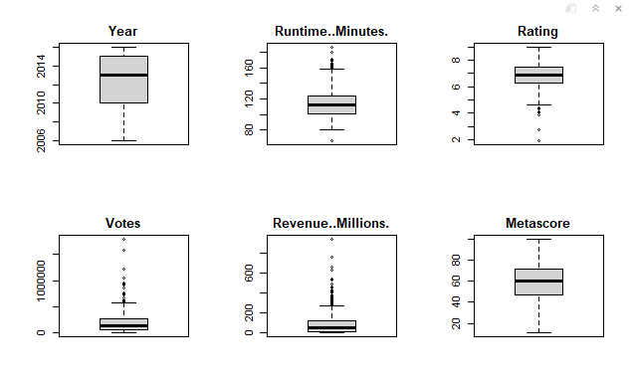
Box Plot

Slide 4
Observation
Maximum number of movies released between 2010 to 2015.
Maximum number of movies run time between 100 to 120 minutes.
Most of the movies rating between 6.5 to 7.5.
Almost all the movies having collection in the range 10 to 120 million.

Slide 5
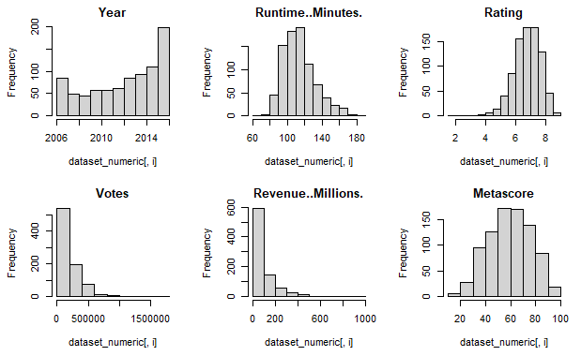
Bar Chart

Slide 6
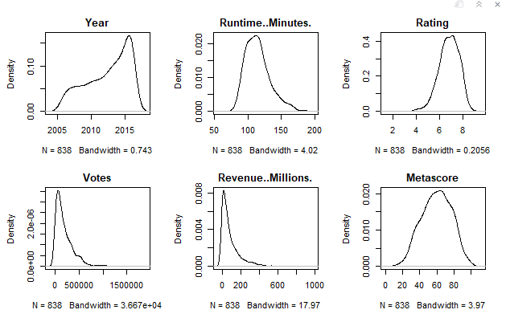
Density Plot

Slide 7
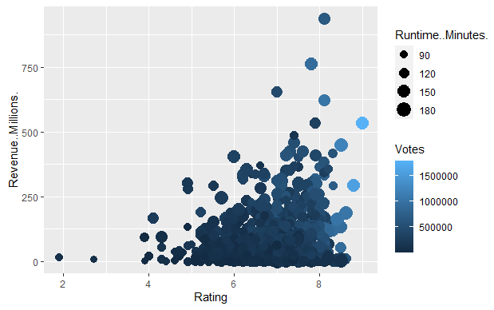
Rating vs Revenue

Slide 8
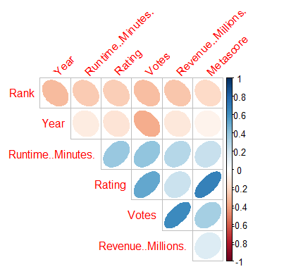
Correlation Analysis

Slide 9
Observation
The correlation shows Rating, Critic score, Votes are positively correlated.
To some extent Revenue also correlated with Rating.
Whenever votes is high, revenue also high.

Slide 10
Conclusion
So, at last we are coming to the conclusion based on our analysis that all genre of movies watched by people but only making of the movie gives difference.
When movie is made good, up to the mark, people give positive reviews that brings rating high. Lot of people give votes for the movie if they liked it.
So, ultimately it generates good revenue.

